Slide 1
Final report
(From Skolkovo to Skokovo)
Team 1

Slide 2
Team members
Electrical engineers:
Nikita – overall
Yaroslav – heating system
Nourhan – energy
Pavel – recovery systems
Victor – recovery systems
Management and organisation:
Andrey – MBSE + doc
Anna – Documentation
Salman Ali – Management + Doc
Natalia – Documentation
Mechanical engineers:
Stepan – Platform
Alexander – Platform
Kate – Platform
Basel – Platform

Slide 3
Mission statement
This mission is dedicated to design, assemble, integrate and
fly the platform for two scientific projects
The GELIOSTAT-1 platform will provide several functions:
1. Delivery of the payload up to the stratosphere
2. Initialize the payload operations and sustain it
operational throughout the mission in it is optimal
working conditions
3. Ensure the safety of the payload
4. Establish communication between the elements of the
mission along with the ground segment
5. Data storage throughout the mission
6. Safe retrieval of the payload by the end of the mission

Slide 4
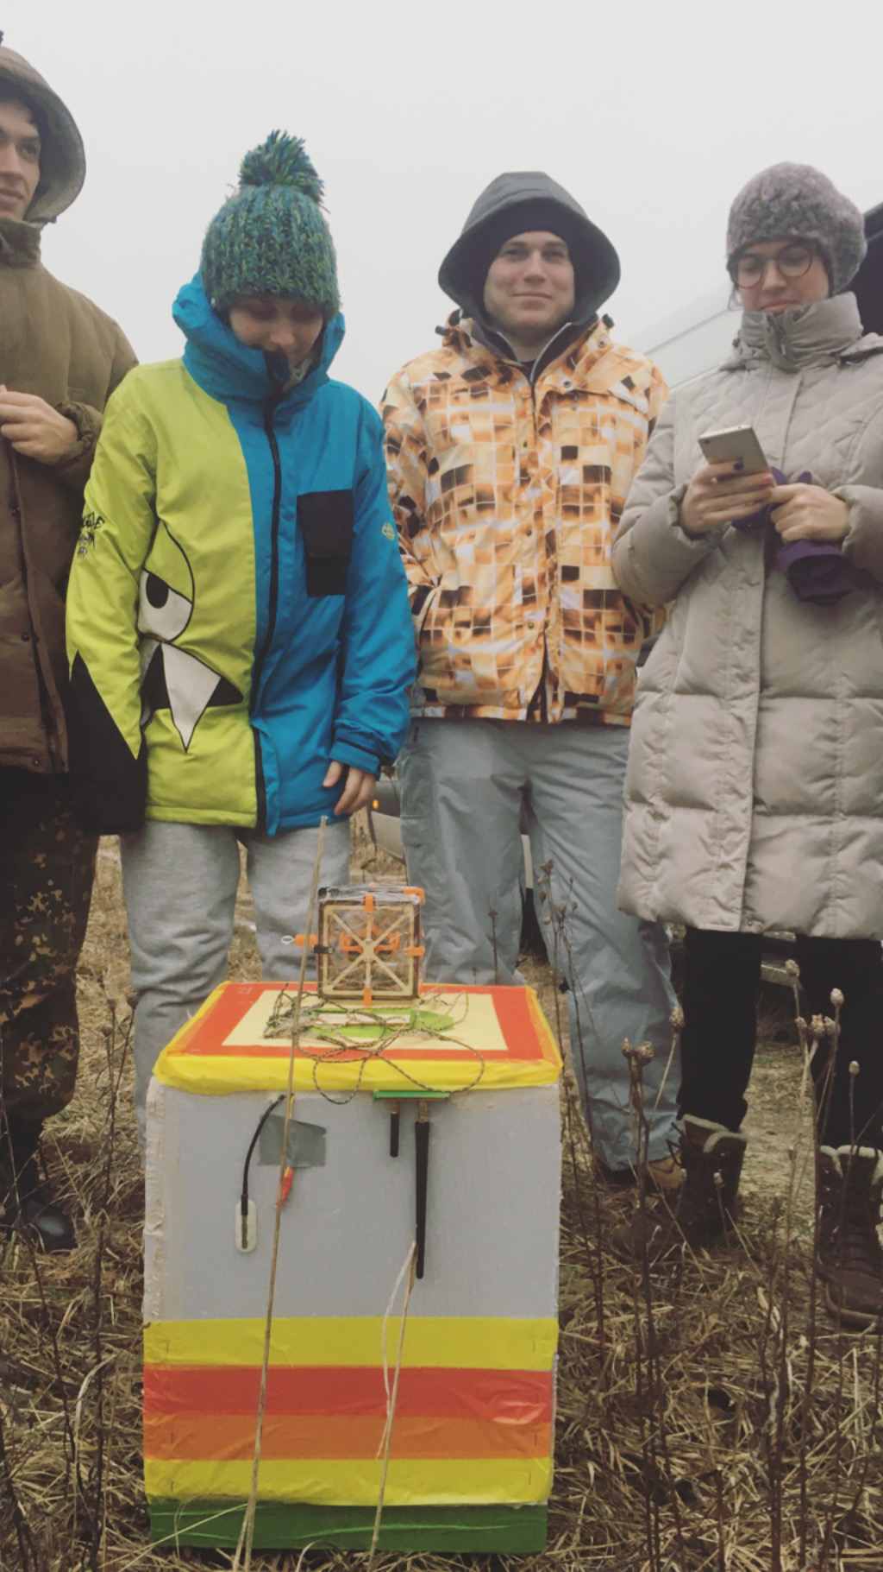
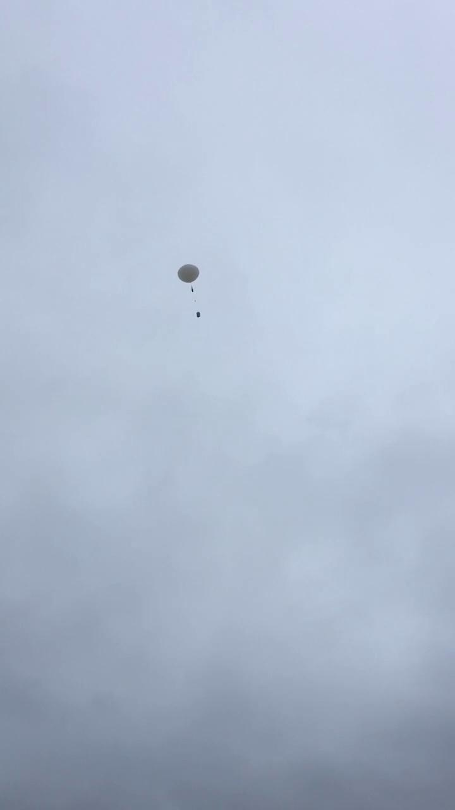
The flight campaign
We began preparing our payload for launch at 10:20 a.m. near Pereslavl-Zalessky and launched it at 12:17 a.m.

Slide 5
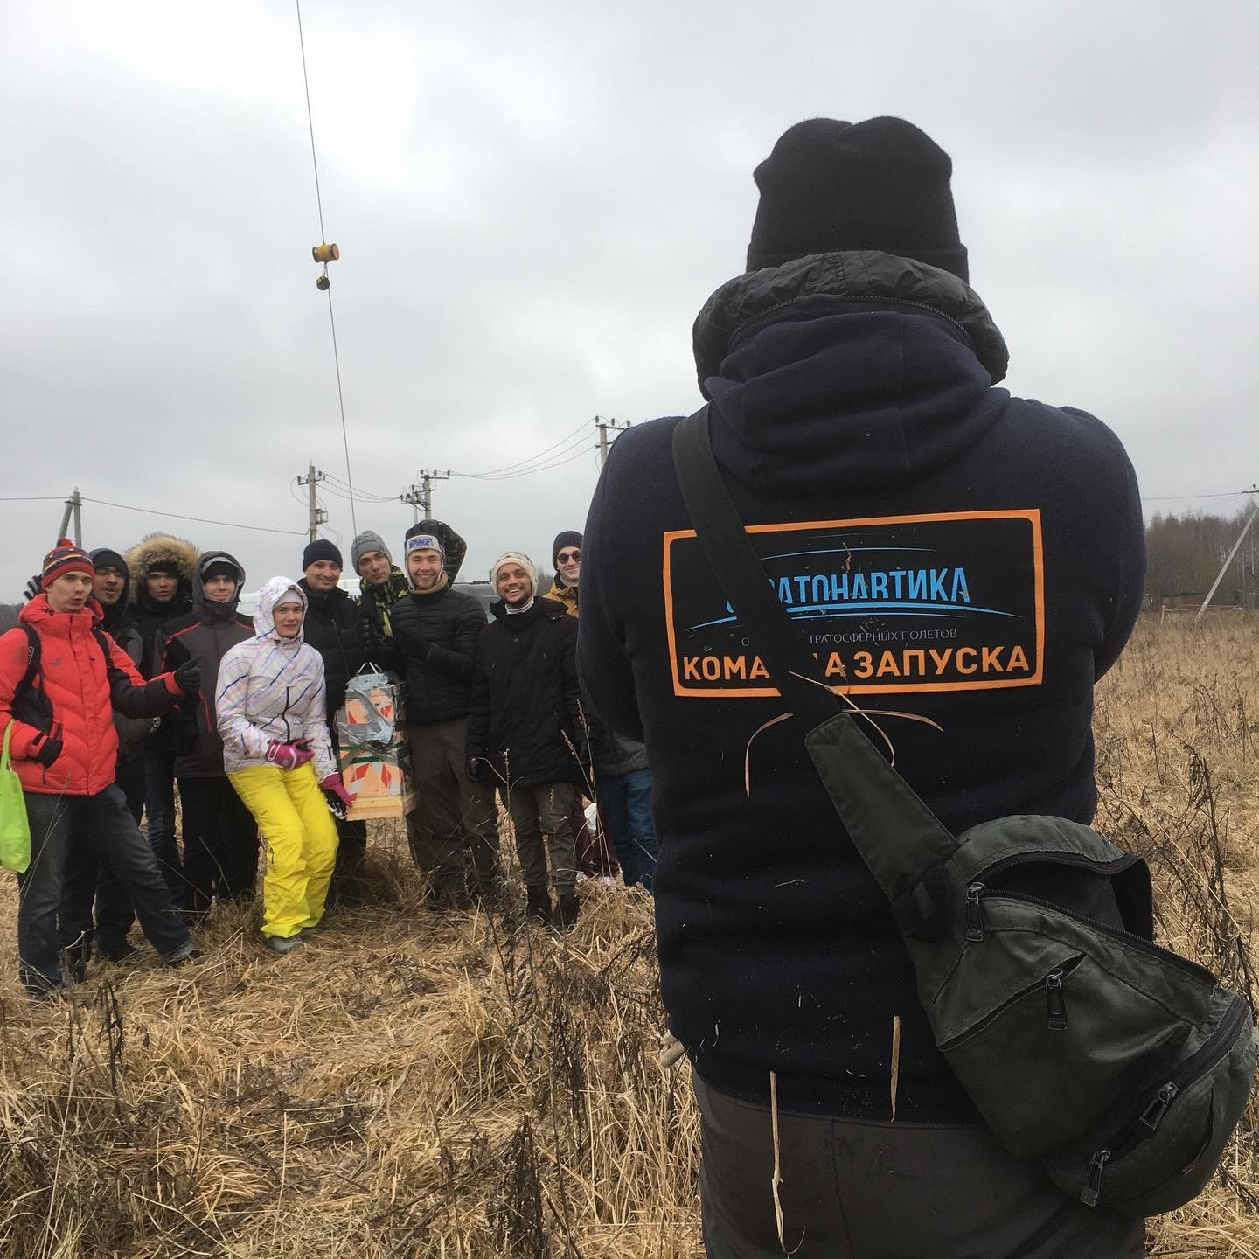
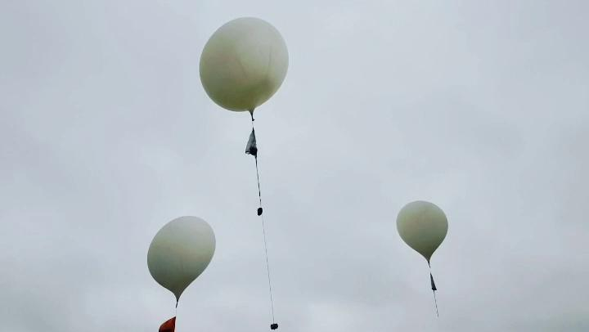
The flight campaign
Balloons were provided by the team of ‘Stratonavtika’ company

Slide 6
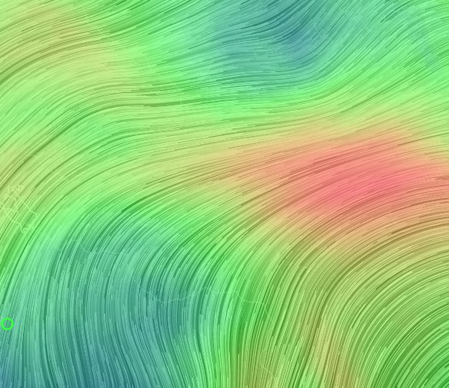
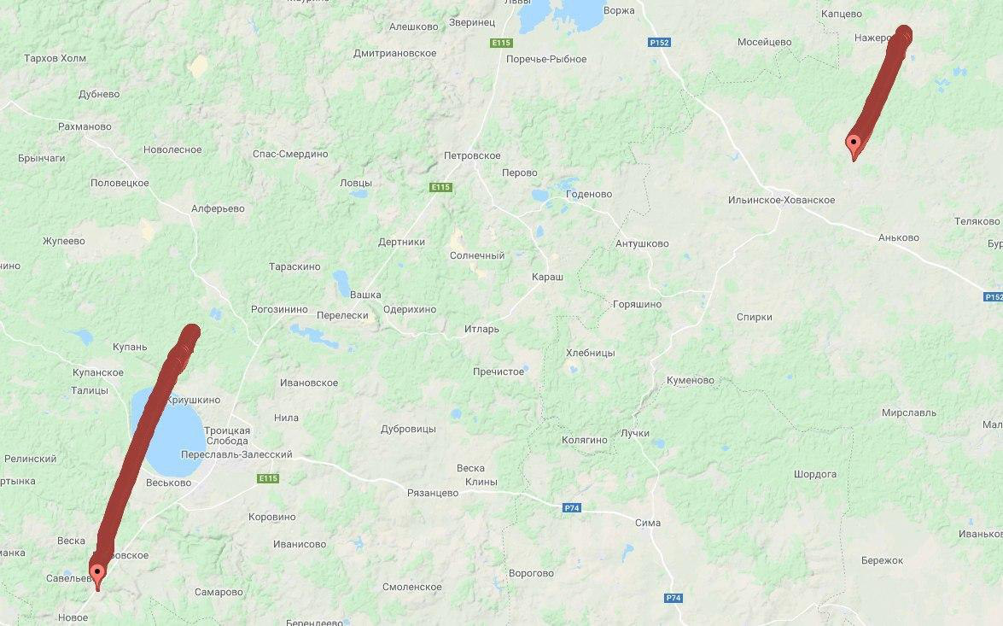
The flight campaign
The map of winds and reconstruction
of the balloon trajectory
Our ballon moved from Pereslavl-Zalessky to the field near Rostov

Slide 7
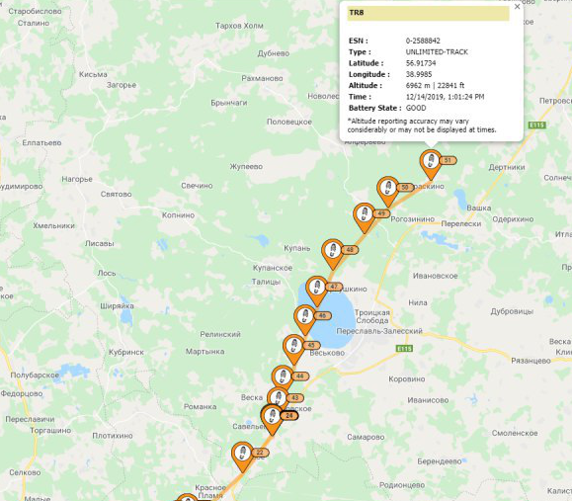
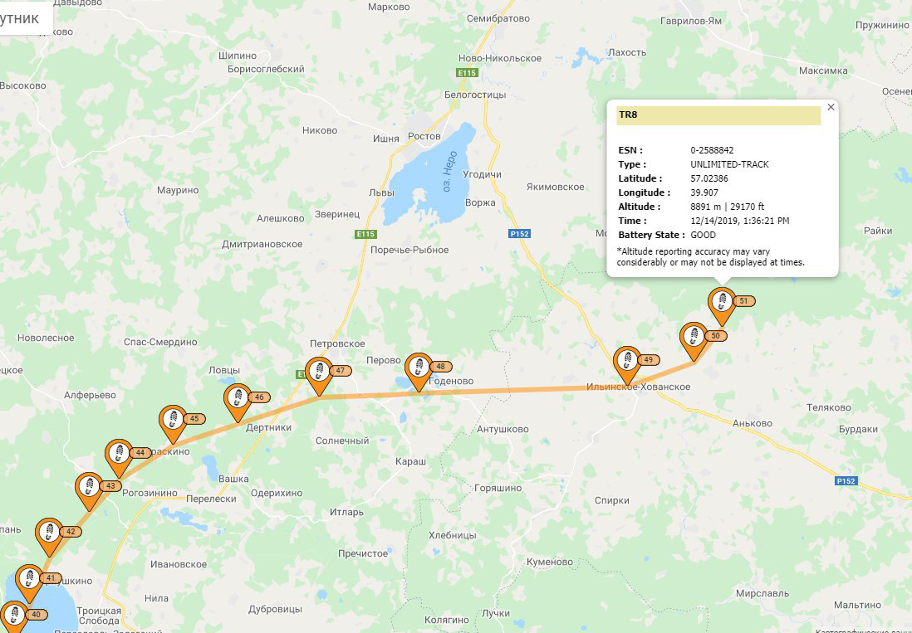
SPOT Trace data

Slide 8
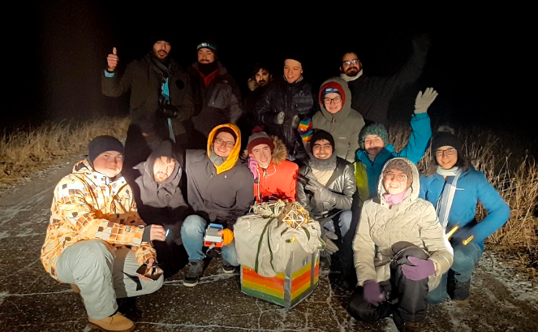
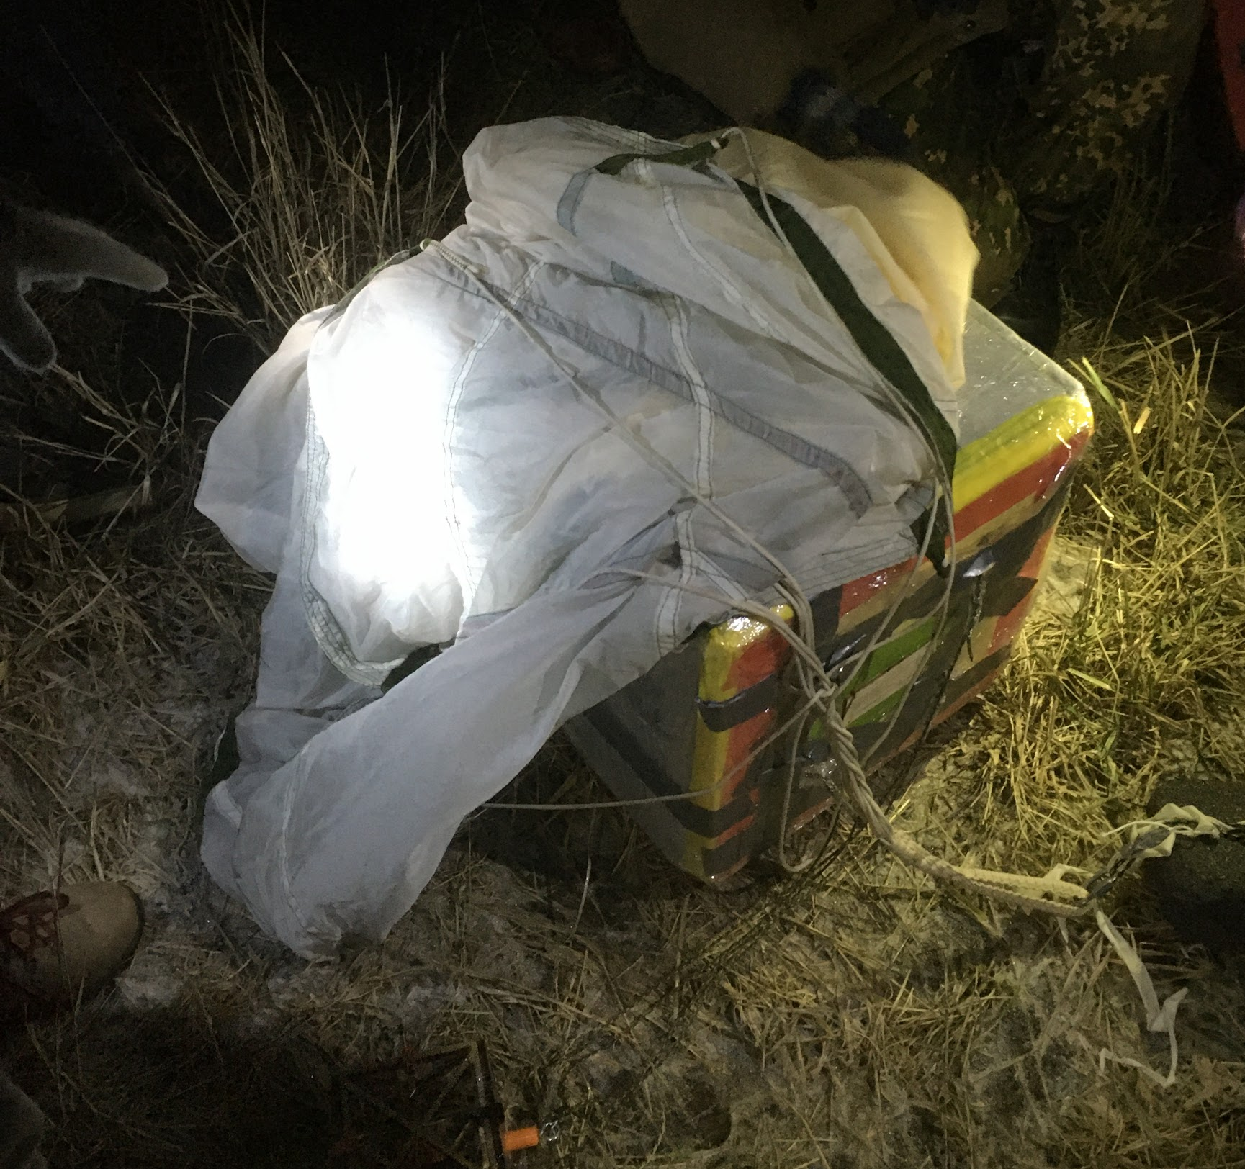
The retrieval campaign
We successfully found our payload on the ground at 18:16, we were really happy!

Slide 9


Slide 10

Results of the mission - ground surface photos
Our payload took photos throughout the flight
This is one of the first images, it shows the road and members of the team

Slide 11
Results of the mission - environment data collection
Recording data by environmental sensors was also successfully carried out throughout the flight
Altitude
Temperature (internal and external)
Pressure
Position

Slide 12
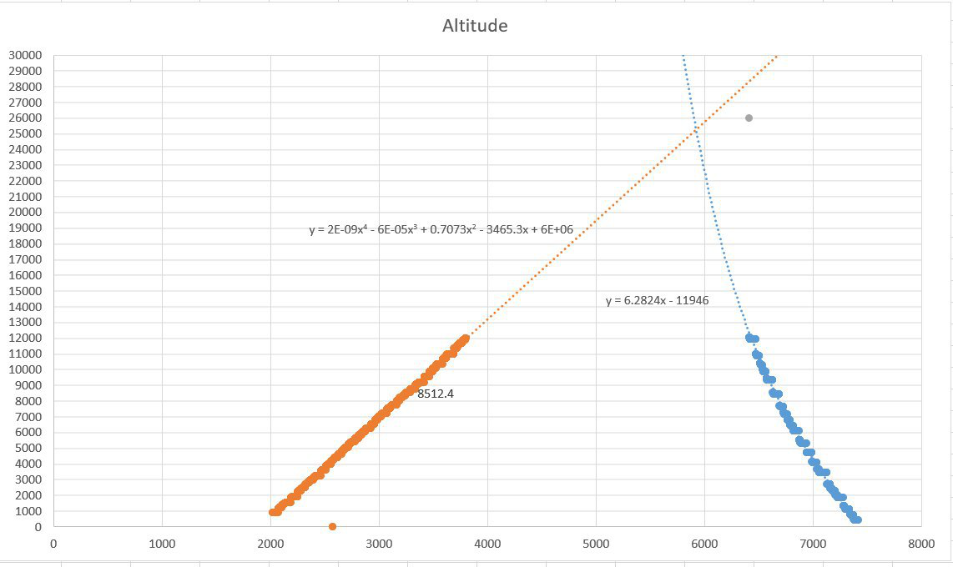
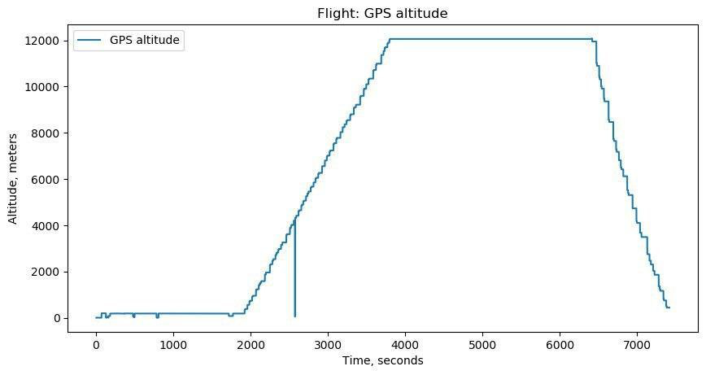
Results of the mission - environment data collection
We calculated possible maximum altitude of our balloon based on altitude that we received from GPS
Maximum altitude ~ 25000m

Slide 13
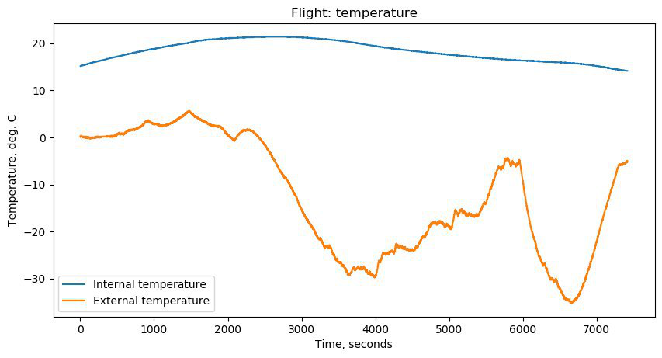
Results of the mission - environment data collection
Temperature in the payload was stable throughout the flight
External temperature seems very realistic

Slide 14
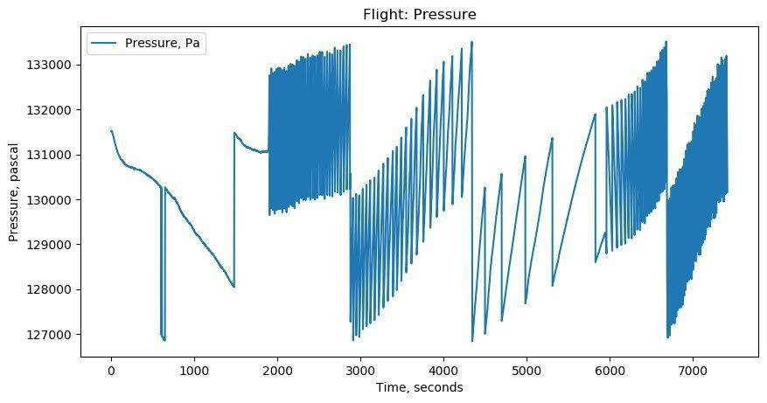
Results of the mission - environment data collection
Pressure outside had a non-real cyclical behaviour of change
We suppose that our barometer was broken

Slide 15
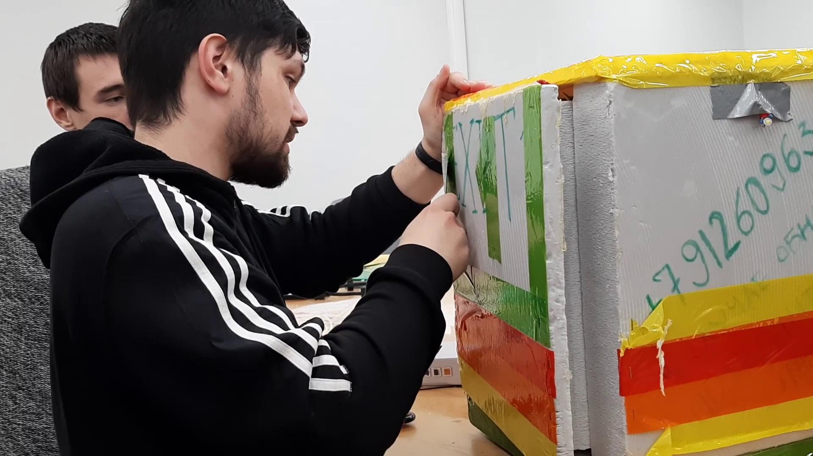
Examination after the flight

Slide 16
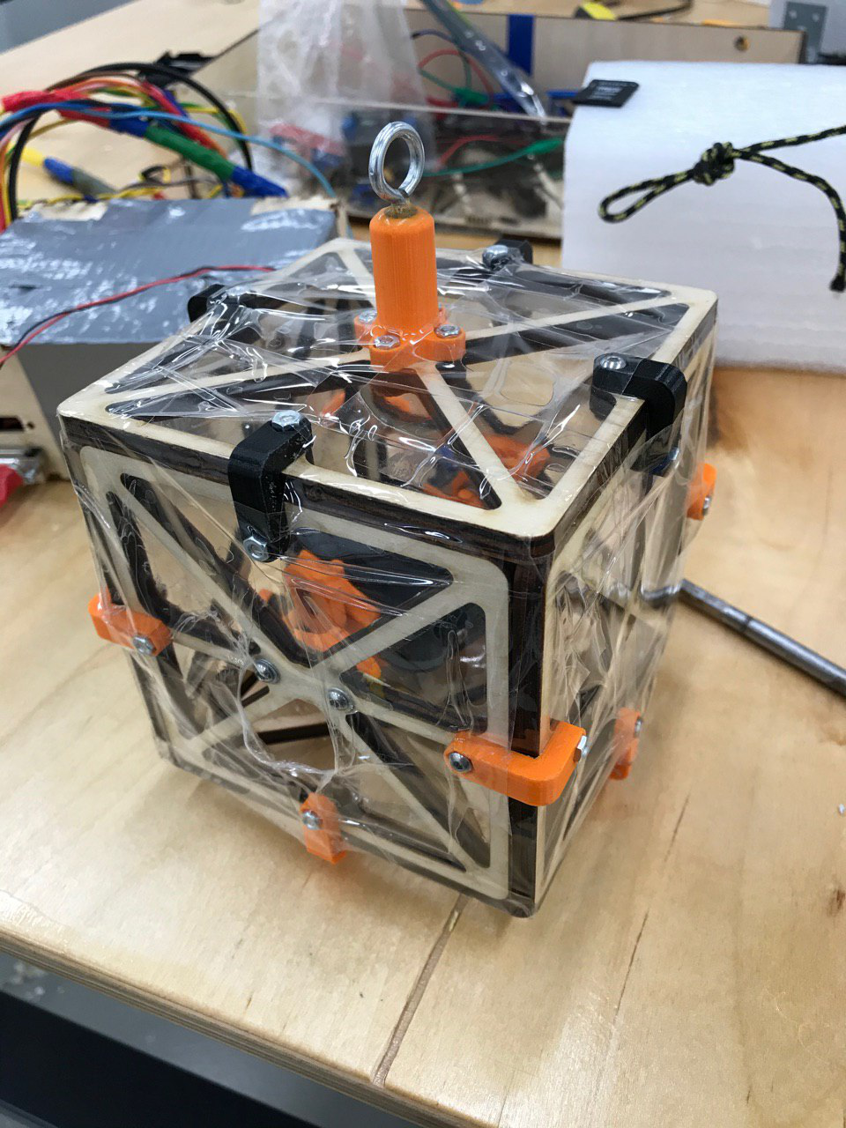
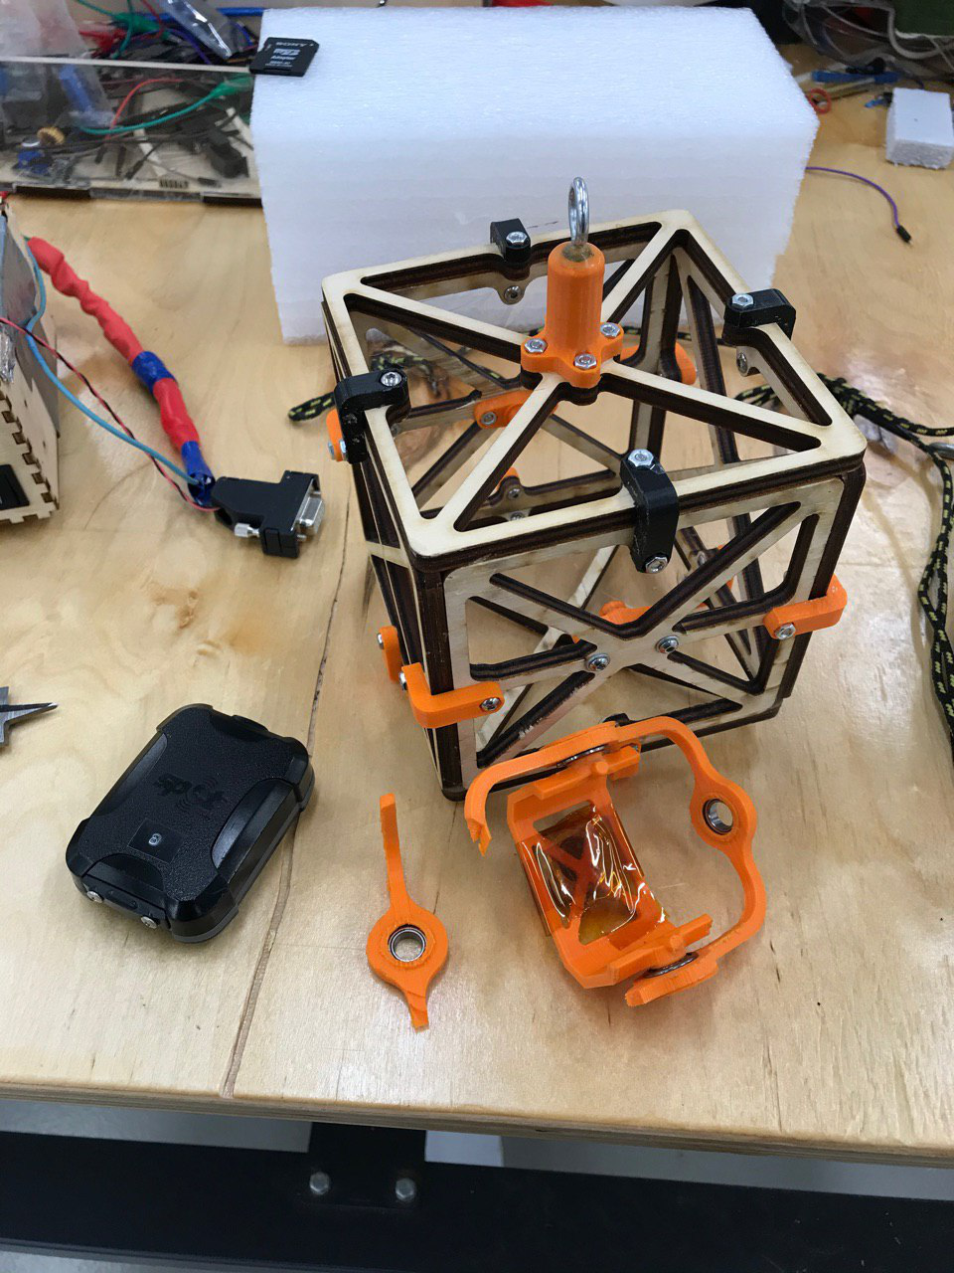
The post flight analysis - mechanical part
Our gyro was not strong enough and broke

Slide 17
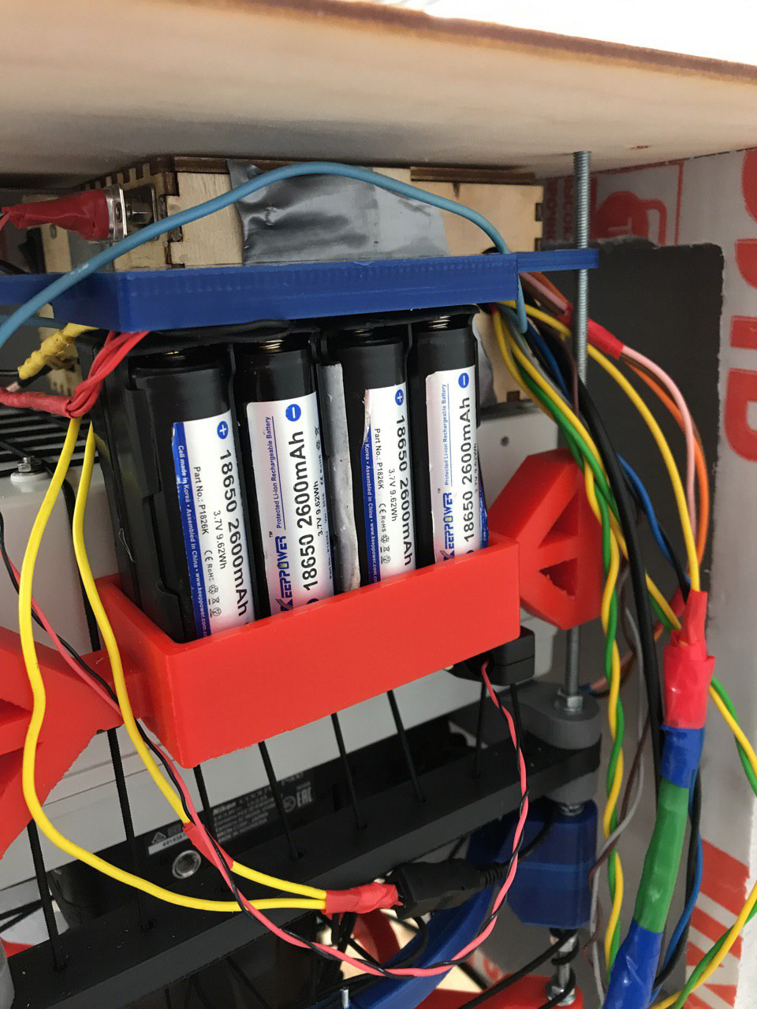
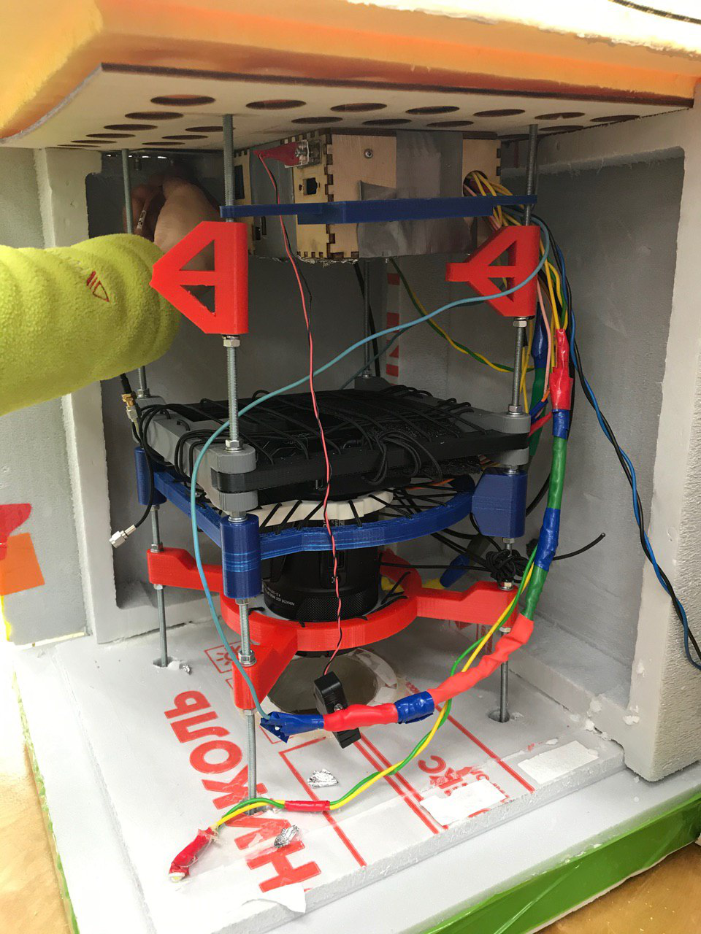
The post flight analysis - mechanical part
Before flight
After flight
Upon landing, the battery packs could not withstand the load and broke
However! Our device was not left without energy after landing, since battery pack never disconnected!

Slide 18
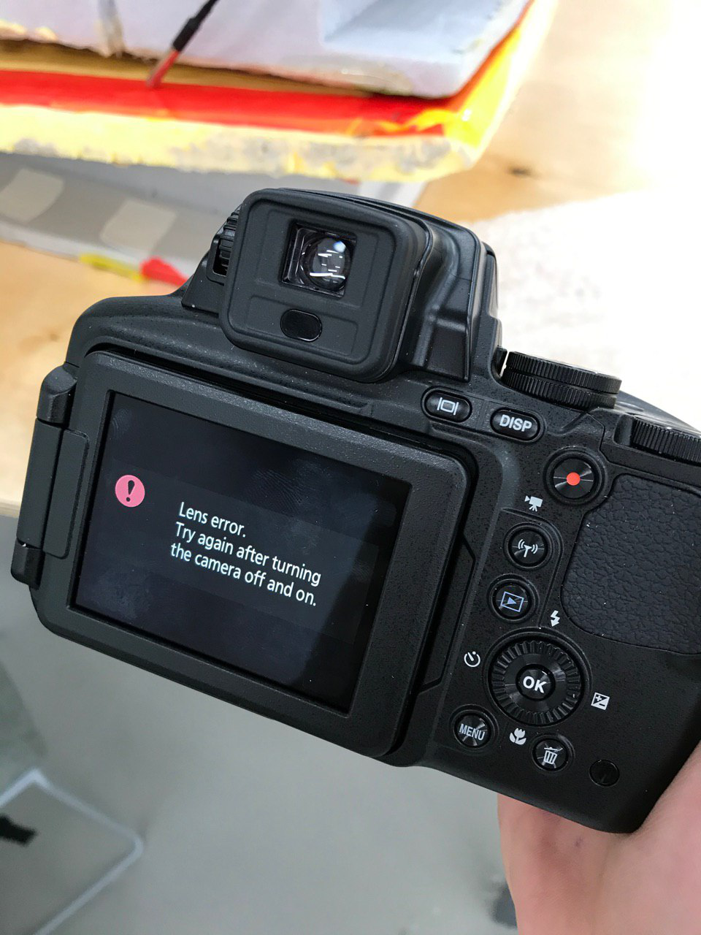
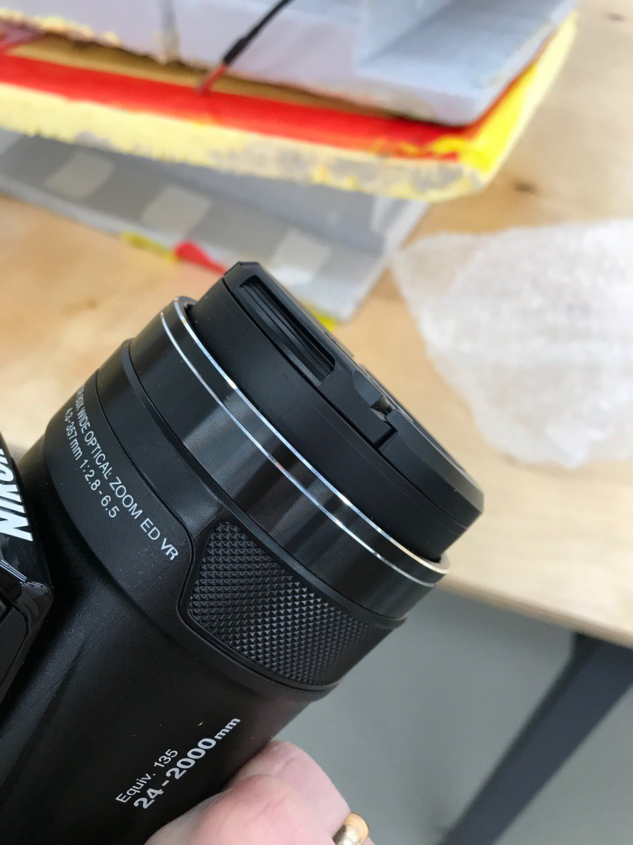
The post flight analysis - mechanical part
The camera was damaged. However, the whole structure that supported it survived
The reason for the breakdown of the camera is unknown. Presumably there was a support stretch and caused the lense mechanism damage

Slide 19
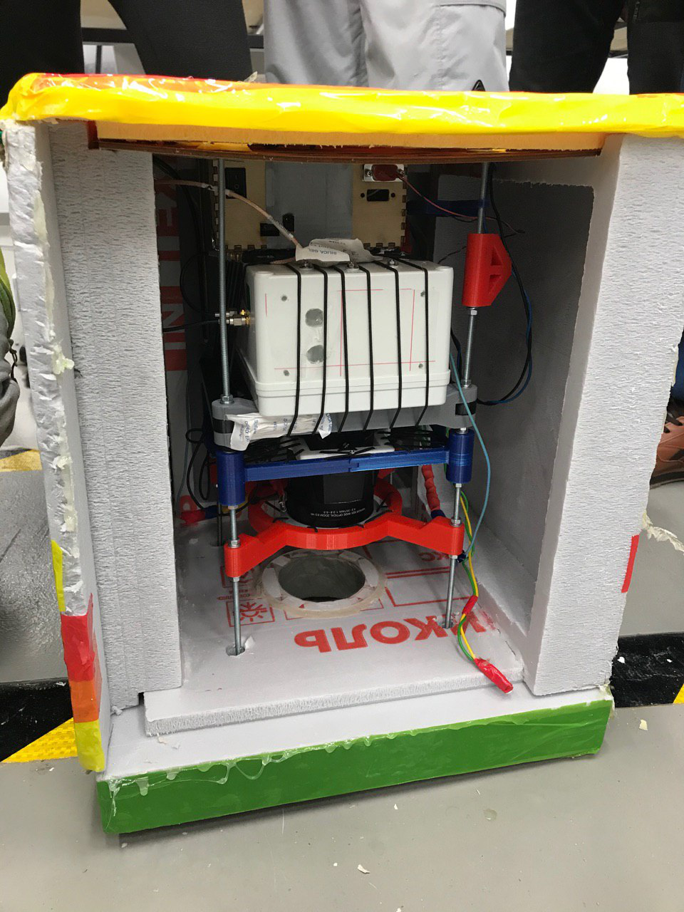
The post flight analysis - electrical part
IMU sensor works pretty well and was not injured after landing but barometr didn’t work well during the flight
Most likely this is caused by the module defective or it broke during the testing of the payload

Slide 20
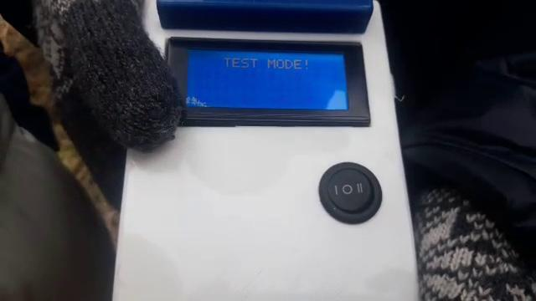
The post flight analysis - beacon system
Pre-flight test was very successful

Slide 21
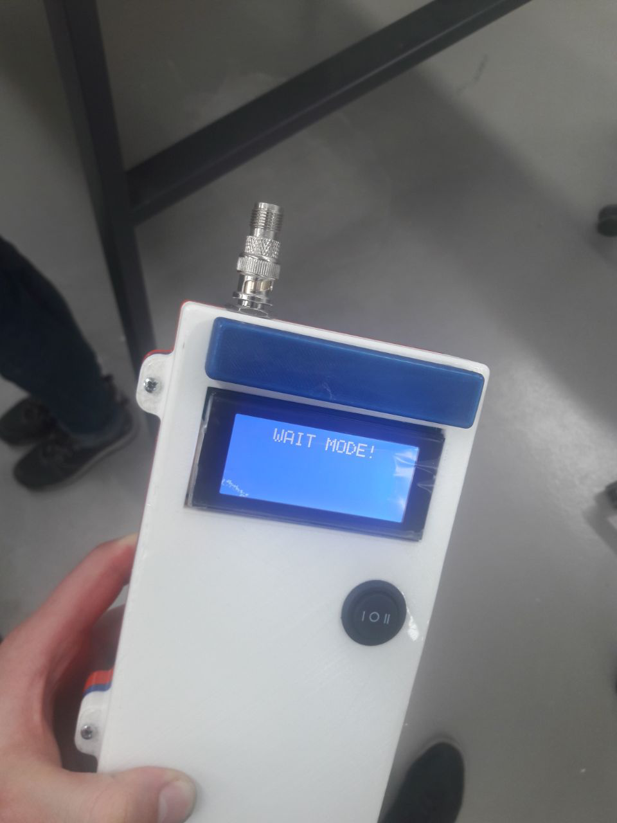
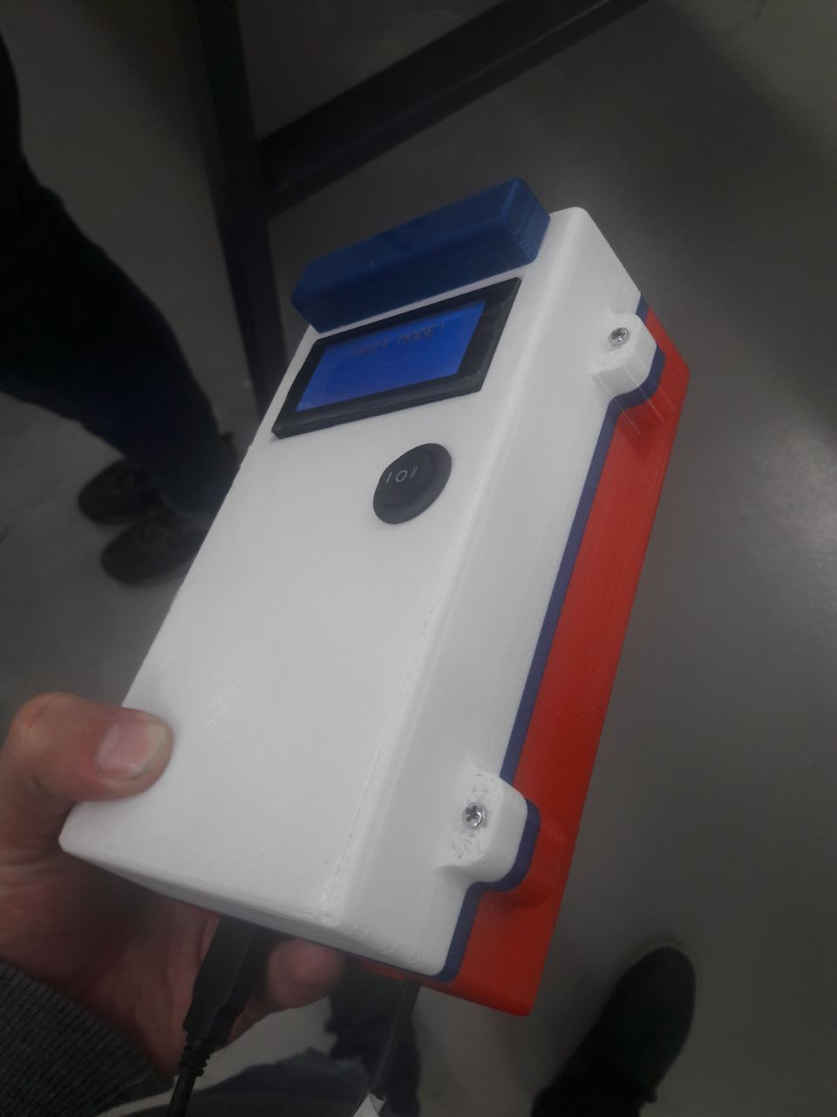
The post flight analysis - beacon system
But after landing, our batteries have discharged and we could neither receive nor send a signal to the payload to turn on the light and sound beacons

Slide 22
The post flight analysis - what needs to be fixed
Gyro design must be stronger
The battery pack must be mounted more securely
Refine camera support
Attach the antenna to the beacon to increase the distance at which it can work
Make a separate backup power supply for beacons

Slide 23
Minimum Success Criteria
We should have at least 70 % of the images saved for the duration of the mission, PLD 2 (TEL-01)
Execute a successful launch sequence (MS 1)
Maximum Flight information to be gathered via telemetry (TEL-02)
Ensure the safety of PLD 1 & PLD 2 & their safe retrieval (PLT-05 & PLT-01 & RE-01)

Slide 24
Is our mission success or not?
Based on the mission statement, minimum success criteria and analyzing our results. Yes, our mission was a success
Successful launch
Successful retrieval
In-flight data storage
Images taken, and saved during the mission
Lastly, we also received good feedback from our customer Joan which endorsed our statement on successfully achieving the objectives
For our other customer, Emre, we did deliver what was asked and retrieved the camera safely

Slide 25
Lessons learnt
Team-Work
Management (both of team and ourselves)
Importance of proper task distribution & delegation
Important to have the right balance in the team in terms of expertise
Retrieval solution should be made more easy
Sometimes it is difficult to communicate with customers and come to terms with their requirements. But it's part of the job!
We could have made a better overview of existing solution, instead of starting outright to work on the platform
Given the budget, high priority should be given to the sensors

Slide 26
Conclusion
All's well that ends well
Except:
We need to have a thorough assessment of what we did (both; right & wrong)
Looking back after completion of the project is one of the most important step
Lastly, this course proved an instrumental learning tool on the importance of systems engineering and its application world-wide

Slide 27
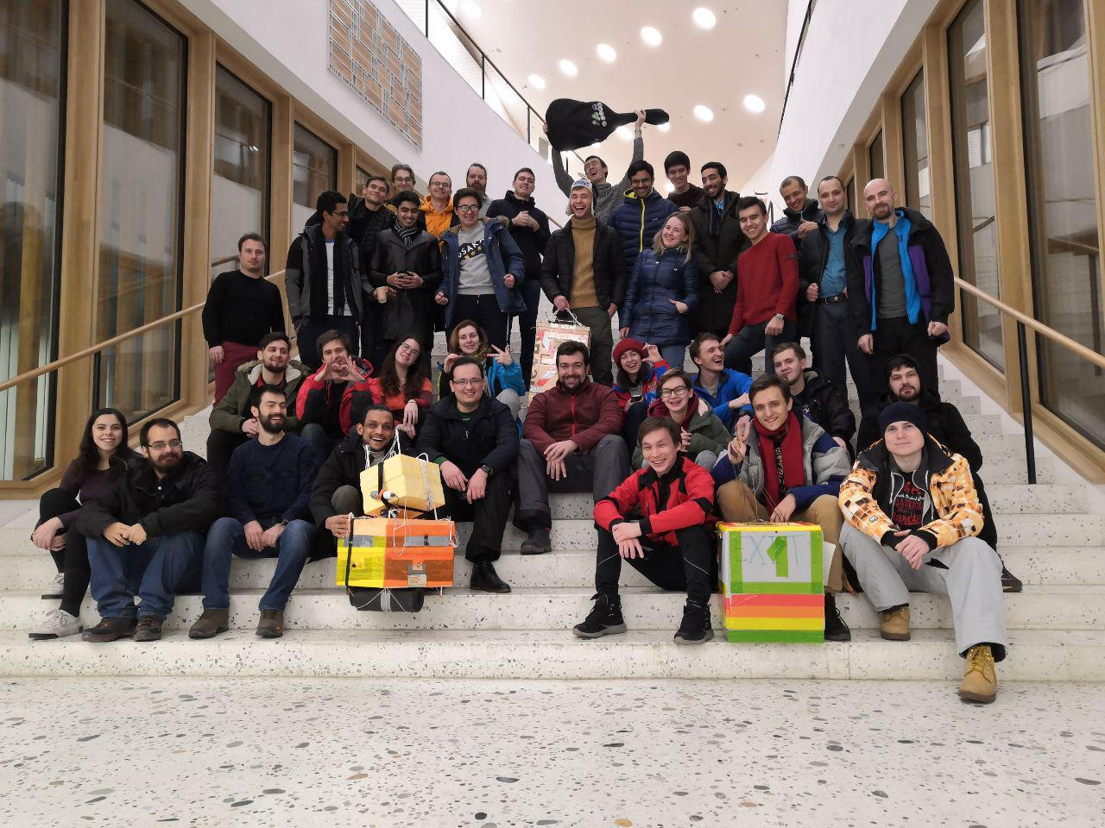
Thank you!

Slide 28
https://docs.google.com/presentation/d/1oEhF79iBdasQX_bPSjFIEbd7jGRGiBQhfP4U-RiV460/edit?usp=sharing

